Slide 1

Fast Fingers!
Analyse your typing – Learn how to type

Slide 2
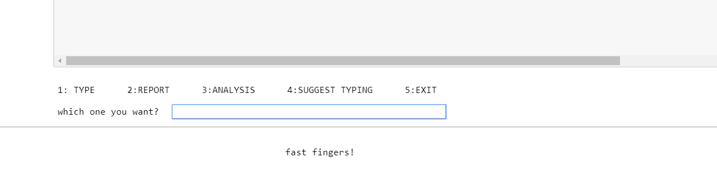
Which One You Want???
1: TYPING 2: REPORT 3:ANALYSIS 4:SUGGEST TYPING 5:EXIT

Slide 3
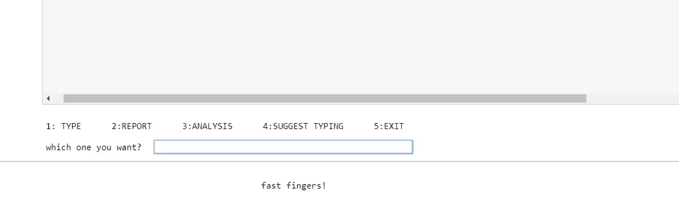
1: TYPING
CLICK TO WATCH THE VIDEO

Slide 4
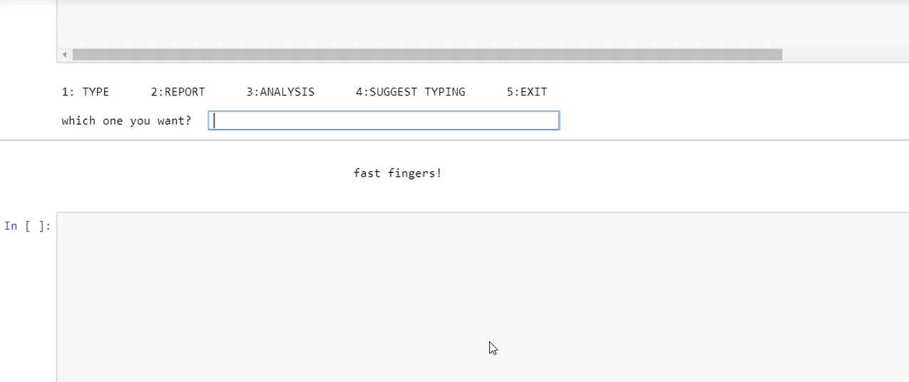
2: REPORT
CLICK TO WATCH THE VIDEO

Slide 5
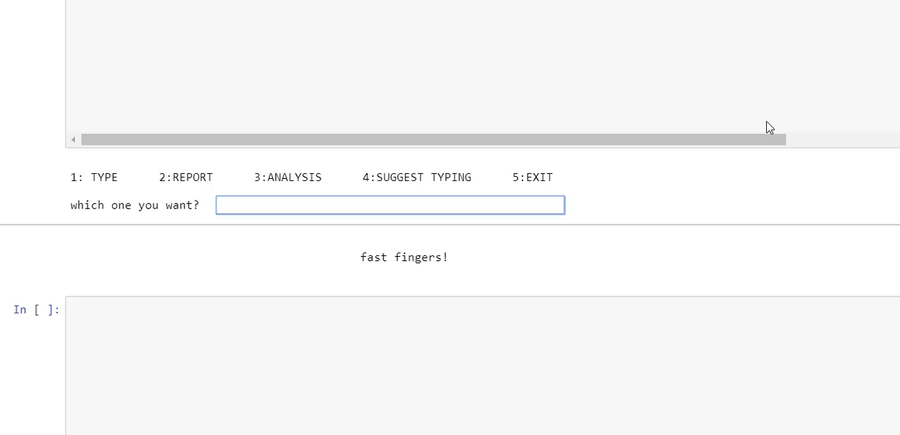
3: PROBLEM ANALYSIS
CLICK TO WATCH THE VIDEO
CLICK TO WATCH THE VIDEO

Slide 6
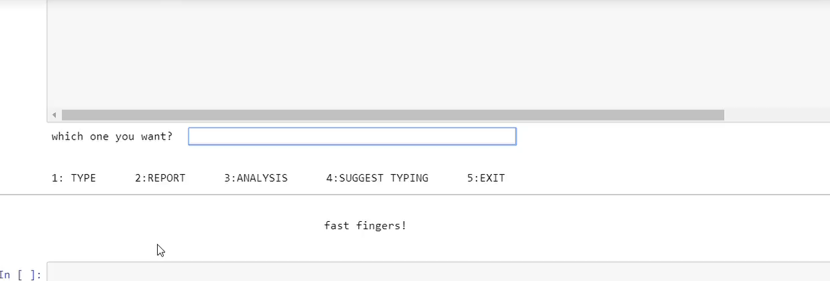
4: SUGGEST TYPING
CLICK TO WATCH THE VIDEO

Slide 7
Thank You

